Slide 1

DESCRIPTIVE STATISTICS
AND
DISTRIBUTIONS

Slide 2


Statistics
Descriptive statistics
Inferential statistics
Descriptive statistics describes statistically a SAMPLE of a group.
It doesn’t try to guess how could be the full group, only the SAMPLE
There is NO UNCERTAINTY
Based on “random SAMPLE” statistics makes inferences about a broader population.
Takes into account the SAMPLING error (each SAMPLE has different statistical properties )
Statistical measures have UNCERTAINTY because of the CHOSEN SAMPLE

Slide 3
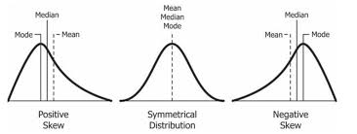
Statistics
Measures of central tendency
Describing the sample
Mean = The average
Median = After sorting the values, the value which has the same amount on values lower than it as the same number of value bigger that in it (“the guy in the middle”)
Mode = The most frequent value

Slide 4


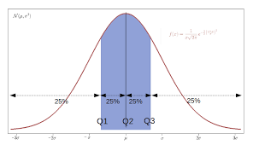
Statistics
Descriptive
Measures of dispersion
Standard deviation (SD):
Variance (SD):
Range = Maximum value - minimum value
Quartiles = Sort your values from the lowest to the highest. Then determine the values for which you have (25%, 50%, 75%) of the total data
Percentiles = Sort your values from the lowest to the highest. Values for which you have a given % of the total data. Quartiles are a particular case of percentiles.

Slide 5
Statistics
We can use the method into a pandas dataframe: describe()
CAVEAT! Only with numerical features.
How we can get all this information with Pandas?

Slide 6

Statistics
Frequency
Number of times that a given value appeared out of total:
Where “ni” is the number of times that a particular value shows up, and N is the total number of values.

Slide 7
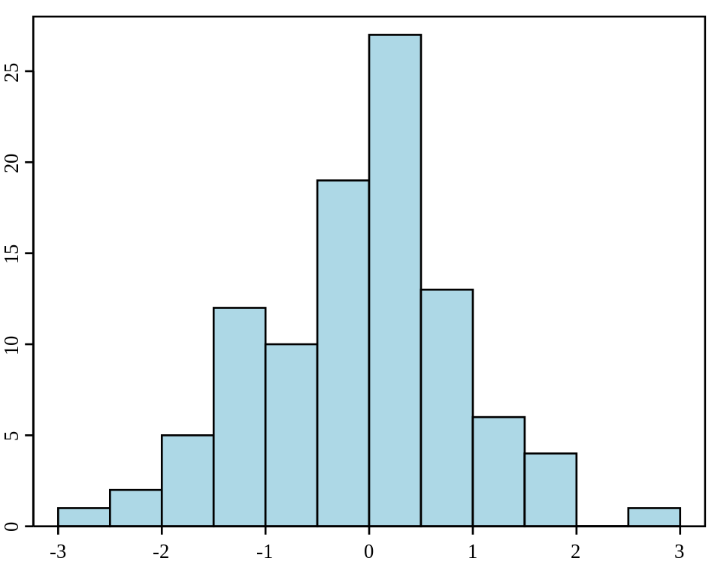
Statistics
Histogram
A histogram is a plot which shows the frequency of a set/subset of values.
The frequencies are show by means of bars whose height is proportional to the frequency of a set of values shown on the x axis.
They can represent continuous values if the full range of values is binned

Slide 8
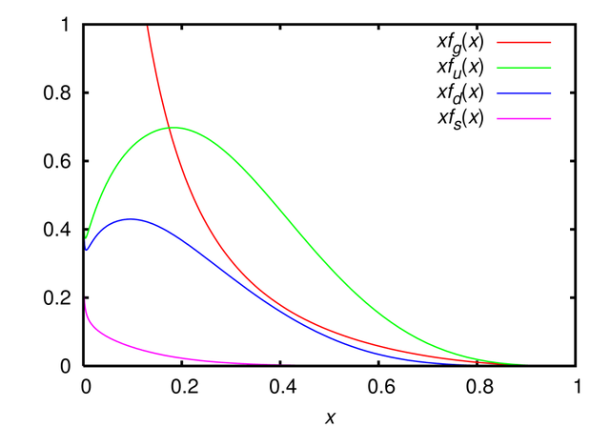
A distribution is a function which gives the likelihood of any specific value shown on the x axis.
They can be seen a limit case of a histogram in which the width of a bar becomes null. The line shows the height of each bar.
The area under the curve up to a given value of the x axis gives the probability of finding any value below or equal to this value
They can have many different shapes.
The difference between the mean, the median and the mode give us an intuition of the shape.
Statistics
Distribution

Slide 9
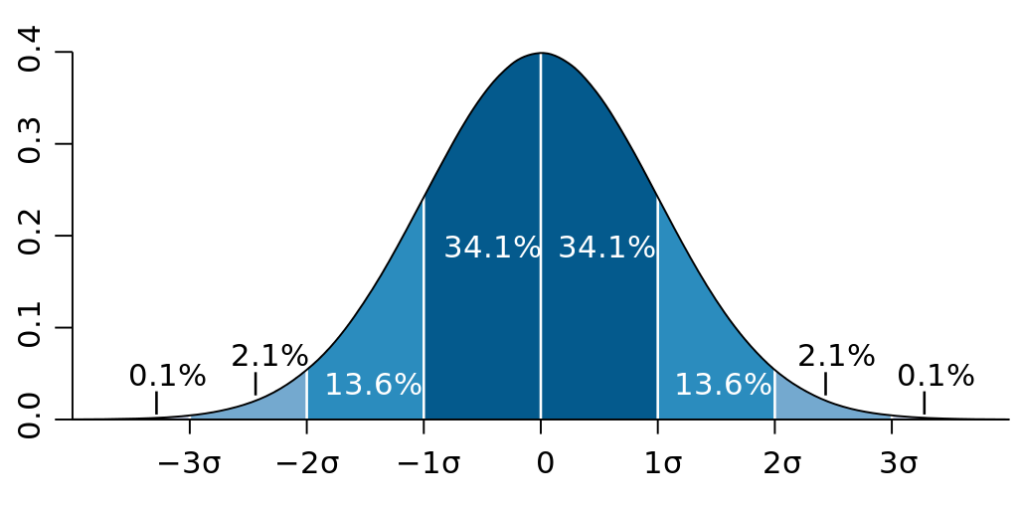
Statistics
Normal distribution
The normal distribution is one particular type of distribution.
It can represent the distribution of sample means regardless of the original distribution.
It’s characterized by two parameters:
Mean ( μ )
Standard deviation ( 𝝈 )
It’s fully symmetrical around the mean.

Slide 10

Statistics
Outliers
An outlier is a value which is extremely bigger or smaller than the others.
Reasons of finding an outlier:
A typo
An underrepresented sample of of a bigger population.

Slide 11

Statistics
There are several approaches to identify them:
Domain knowledge
Sorting the values ( the outliers will be easier to identify)
Get the box-plot ( outliers are isolated values outside the whiskers )
Ways to deal with them:
Fix the value is it’s a typo
Remove them or change their values to the closest whisker
Dealing with outliers

Slide 12
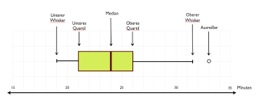
Statistics
A “box-plot” is an schema which basically displays:
Q1, Q2, Q3, Q1-1.5(Q3-Q1), Q3+1.5(Q3-Q1)
Box-plot

